Slide 1
Design and Implementation of Mobile Applications
Gabriele Aldeghi
17 Febbraio, 2019

Slide 2
Application scope

Slide 3


Application scope

Slide 4

Application scope

Slide 5

Application scope

Slide 6

Application scope

Slide 7

Application scope

Slide 8

Application scope

Slide 9

Application scope

Slide 10
Application goals
Connect Mentors and Mentees
Allow Mentors to test the Mentees
If connected, allow them to chat

Slide 11
Application screens

Slide 12
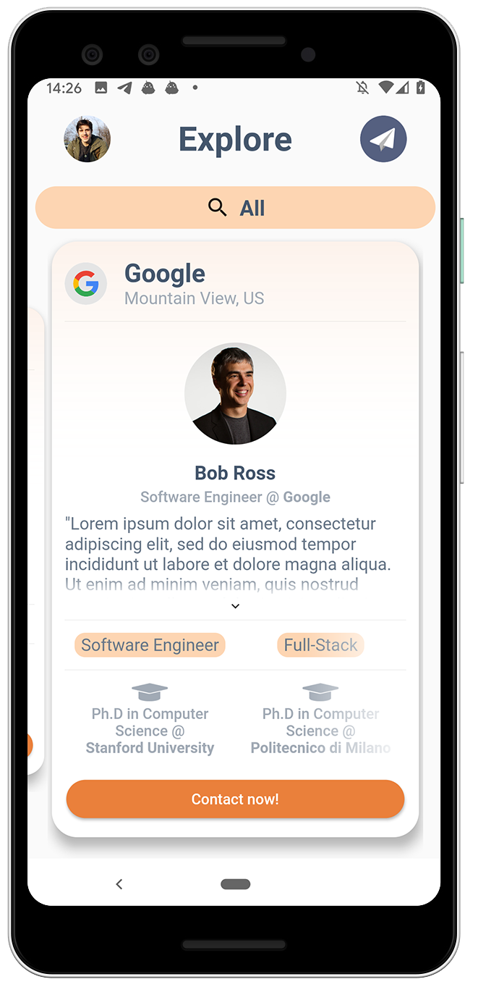
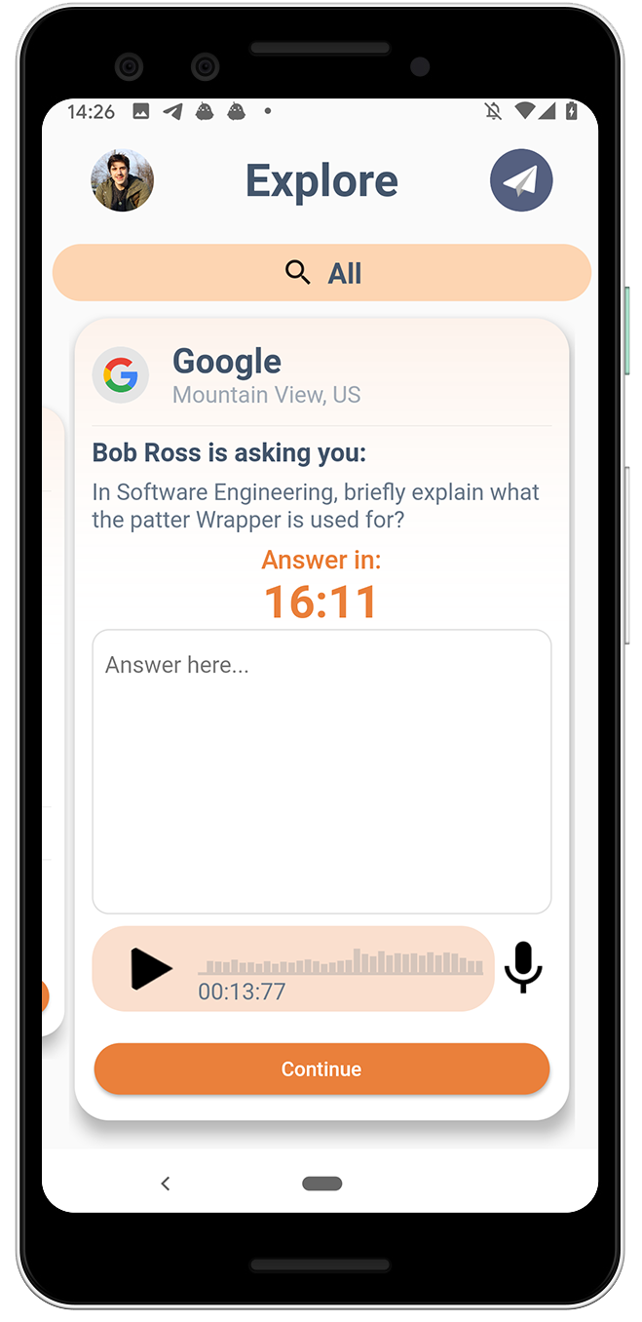

Slide 13
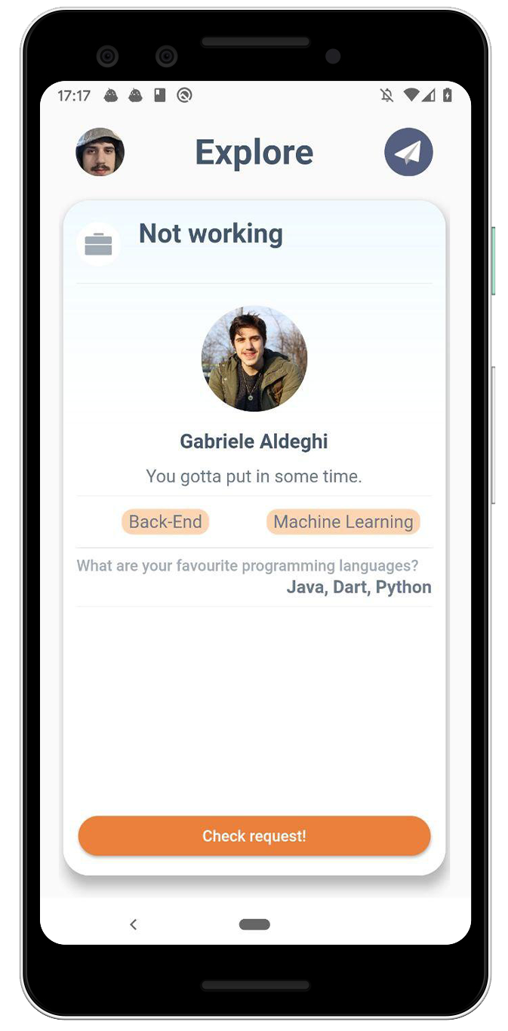
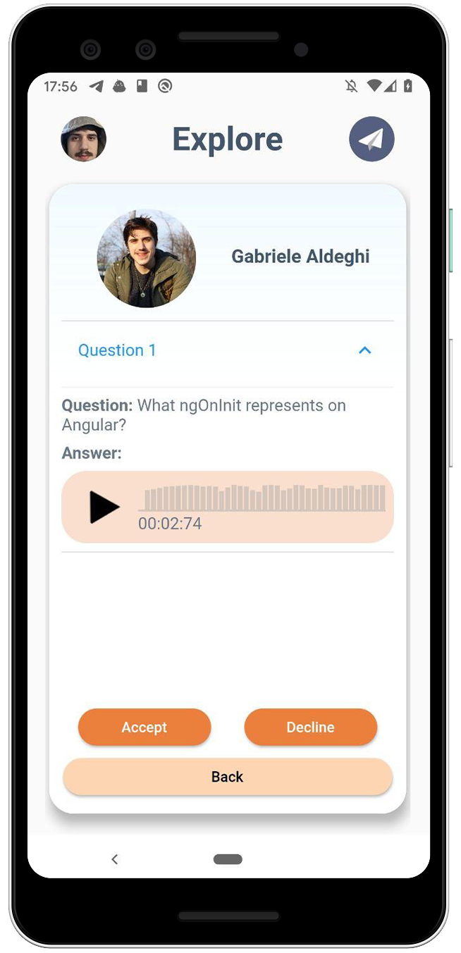

Slide 14
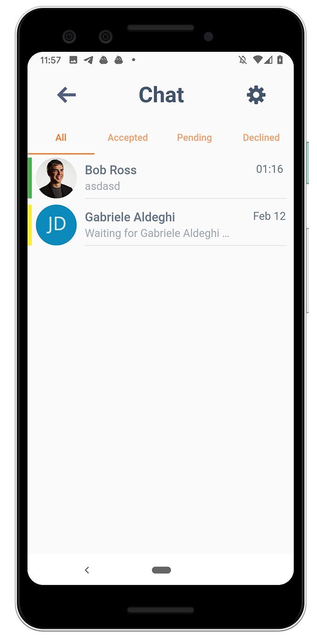
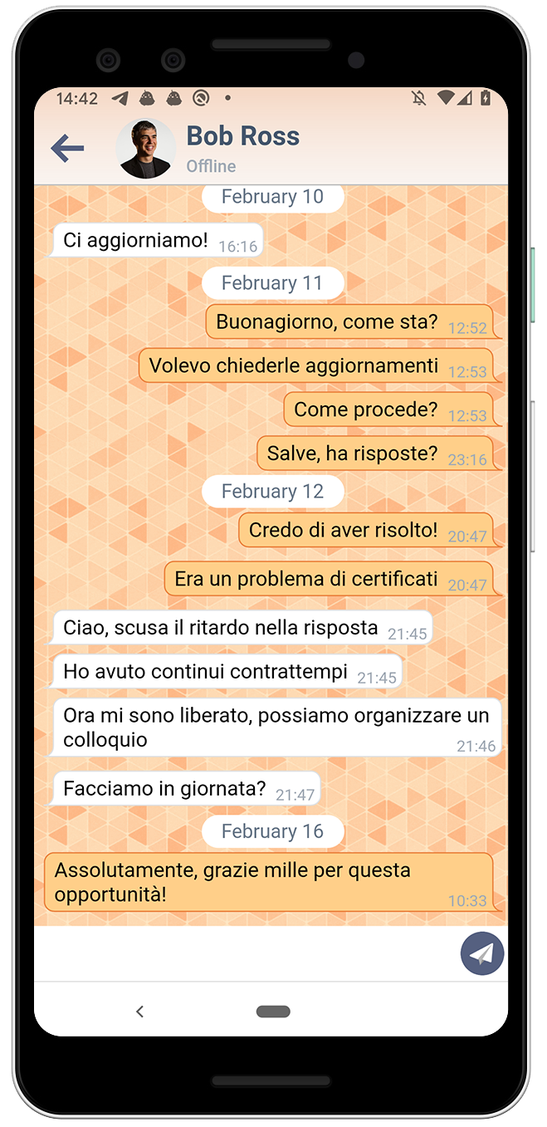

Slide 15
Implementation details

Slide 16
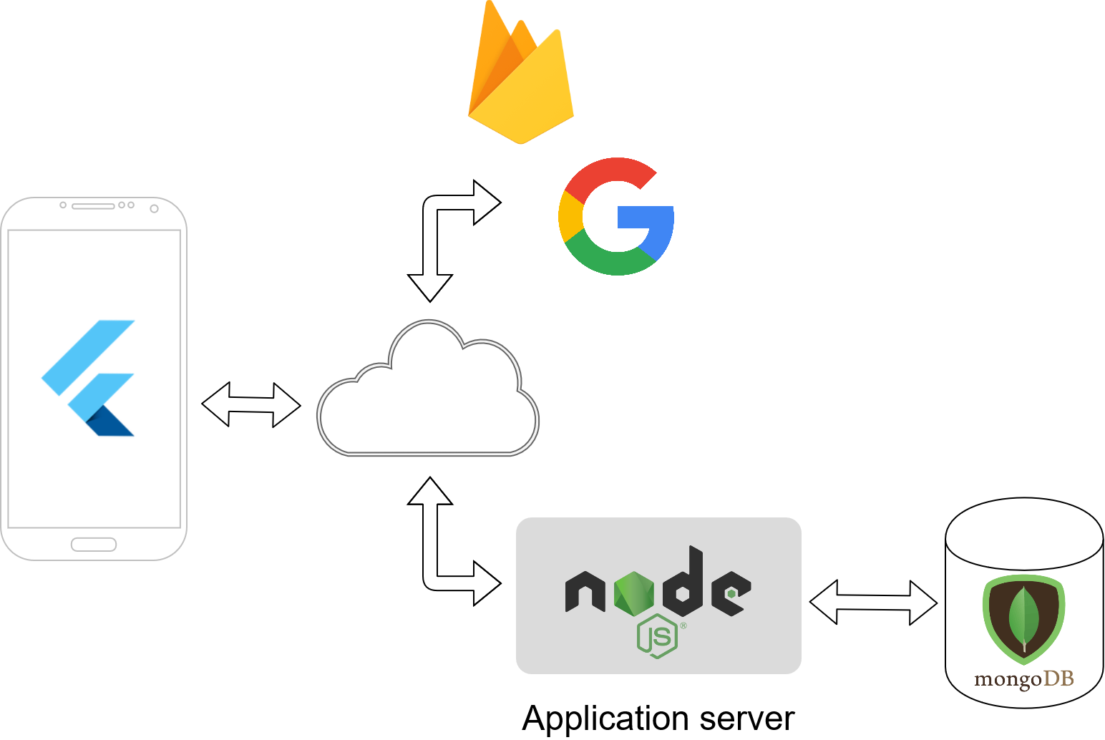
Implementation details

Slide 17
Application
State Management: BLoC
Interaction with camera and microphone
Authentication with Google, push notification with Firebase Cloud Messaging

Slide 18
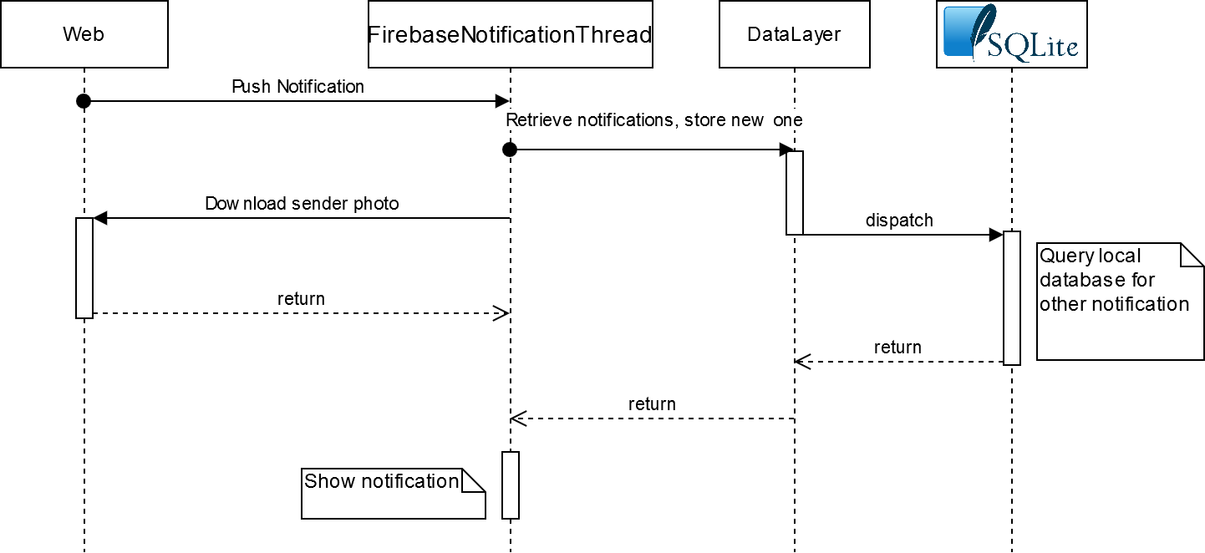
Background notifier thread

Slide 19
Live demo

Slide 20
Thank you for your attention!
Gabriele Aldeghi - 899733

